Slide 1
Hardware Test report BD668A JIG Test
신제품개발팀 한승한 선임

Slide 2
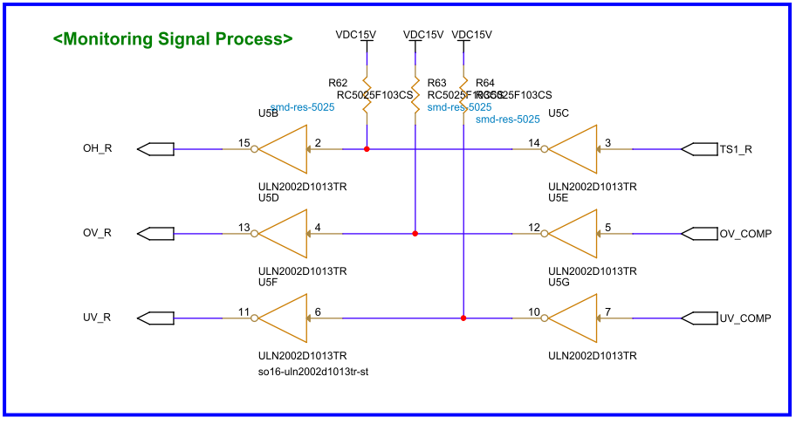
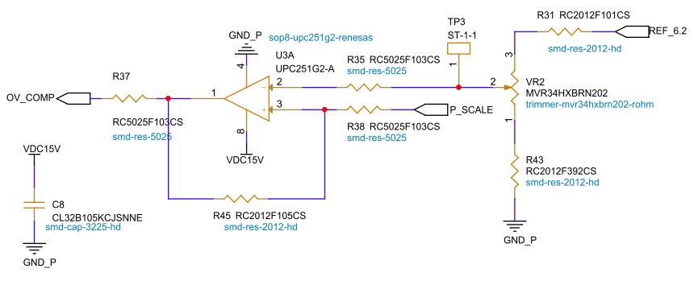
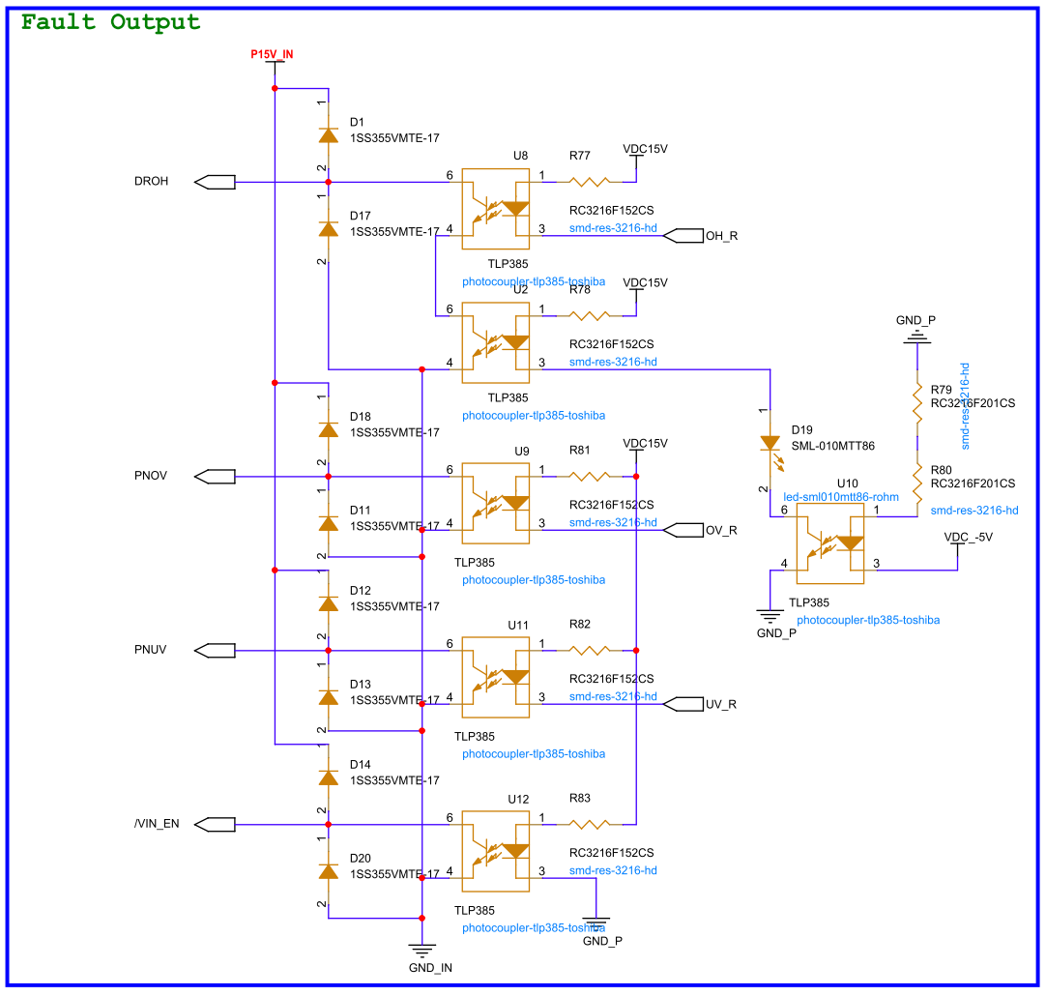
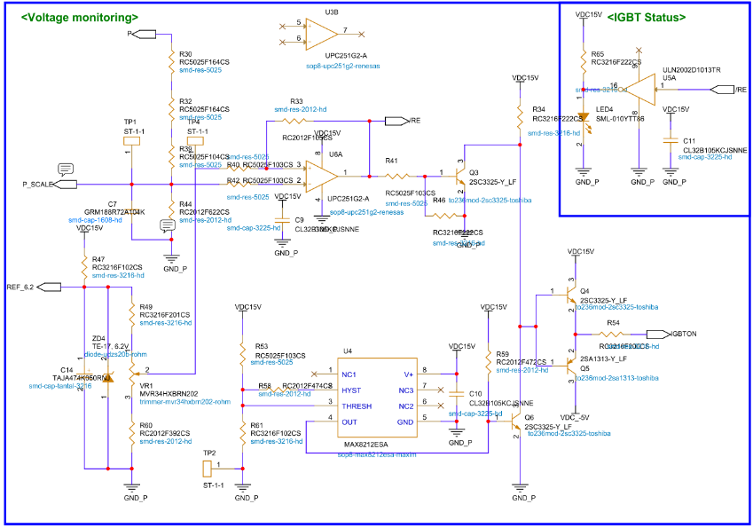
H203
Using Power supply
OV_COMP
TP1
TP2
TP1
PNOV
+
-
1
2
3
4
Power Supply
Oscilloscpoe

Slide 3
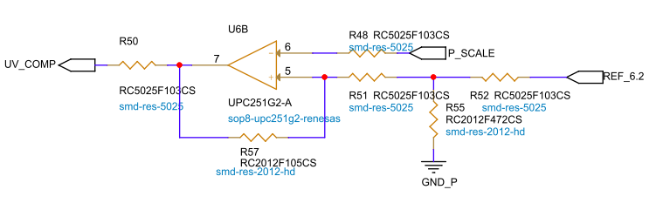
H204
Using Power supply
UV_COMP
TP1
TP2
TP1
PNUV
+
-
1
2
3
4
Power Supply
Oscilloscpoe

Slide 4
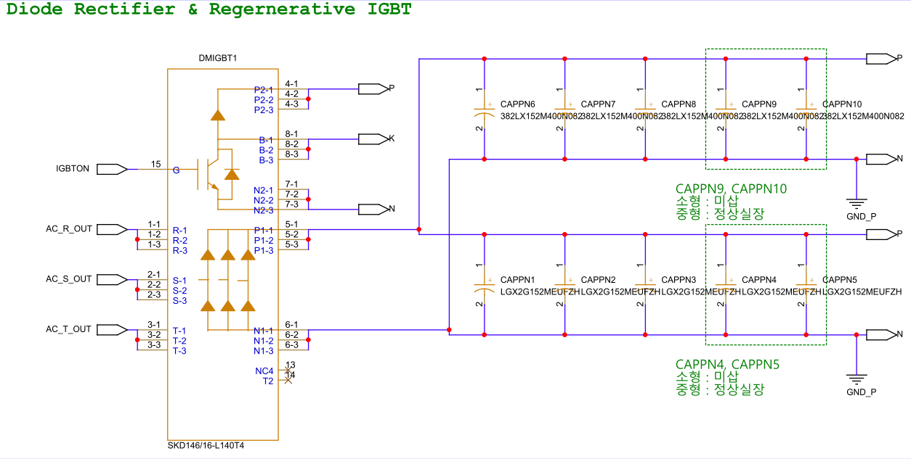
H205
K
N
+
-
Multimeter
(저항모드)
Using Power supply
/RE
TP1
TP2
TP1
IGBTON
+
-
1
2
3
4
Power Supply
Oscilloscpoe

Slide 5
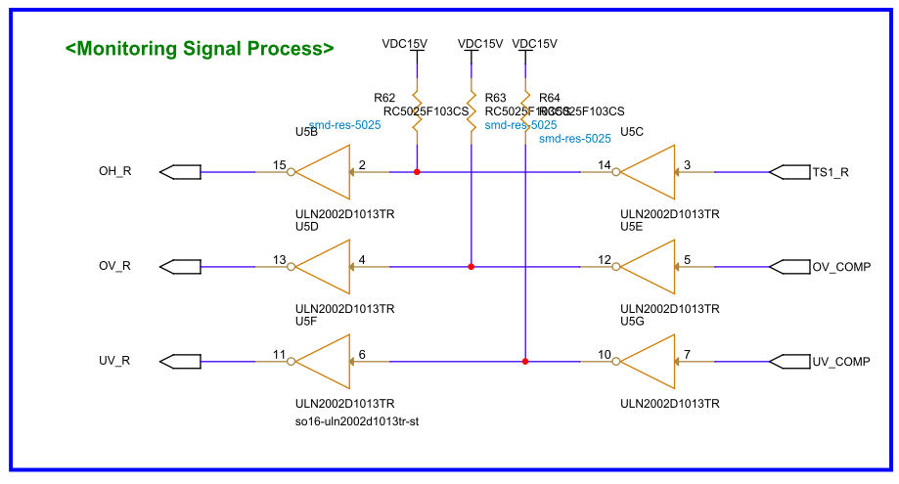
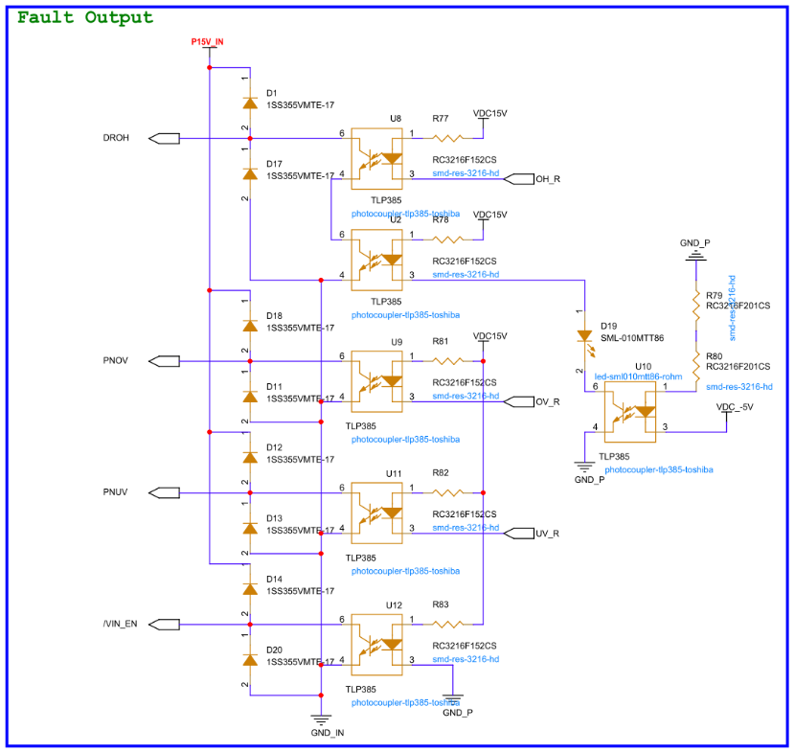
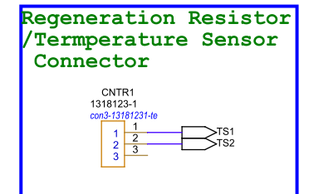
H206
Using Regenerative discharge resistor (temperature sensor)
DROH
OH_R
1
2
3
4
Oscilloscpoe

Slide 6
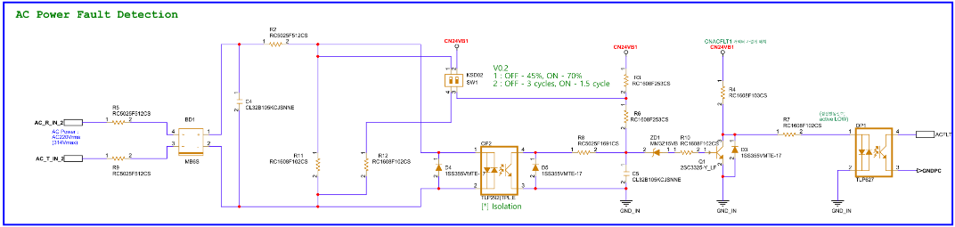
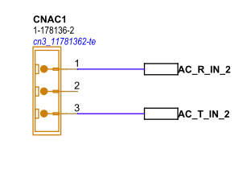
H209
ACFLT
GNDPC
+
-
Multimeter
(저항모드)
Using AC power (Hi6-T15 Controller)
OP1 1번핀
R-T
1
2
3
4
Oscilloscpoe

Slide 7
Hardware Test report BD668A Controller Test
신제품개발팀 한승한 선임

Slide 8
H201
Using Controller
S-T
P, N
R-S
T-R
1
2
3
4
Oscilloscpoe

Slide 9
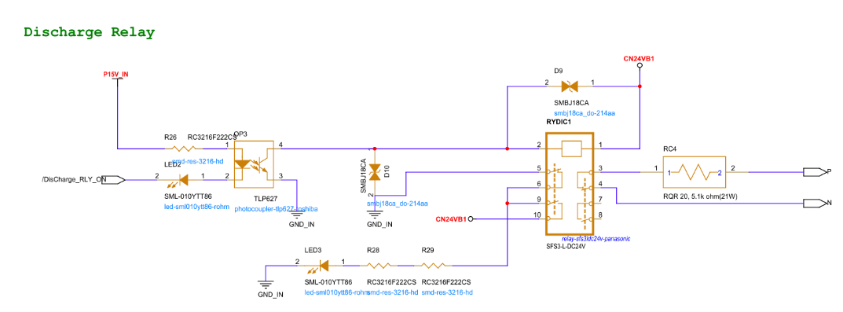
H202
Using Controller
P-N
/Discharge_RLY_ON
1
2
3
4
Oscilloscpoe

Slide 10
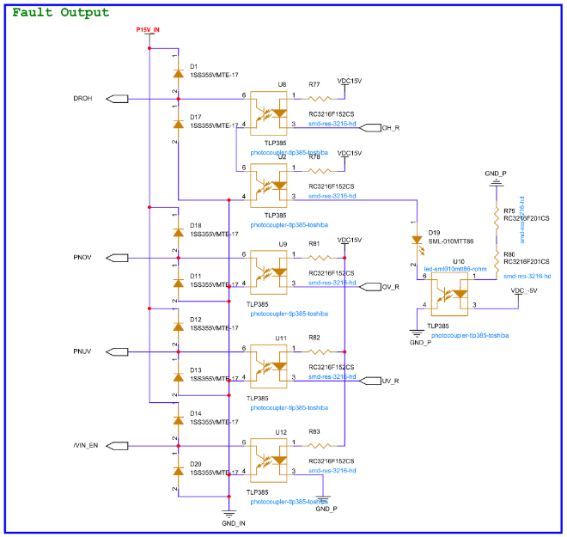
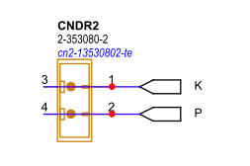
H207
Using Controller, Discharge resistor
DROH
OH_R
1
2
3
4
Oscilloscpoe

Slide 11
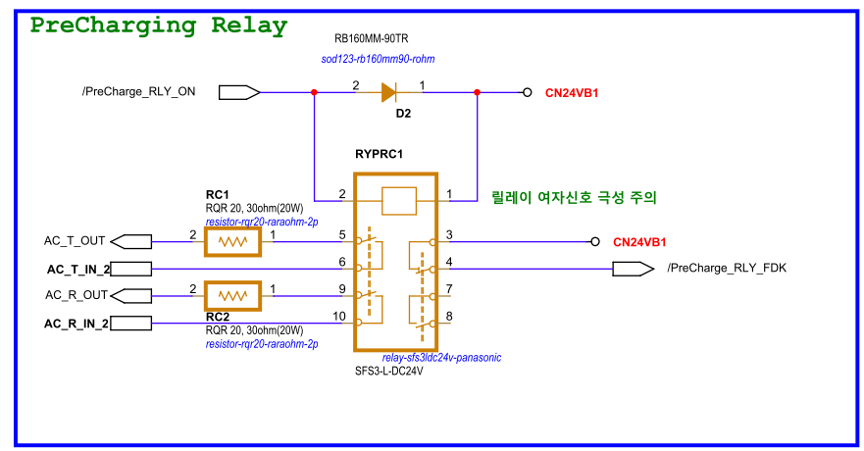
H208
Using Controller
P-N
/PreCharge_RLY_ON
/PreCharge_RLY_FDK
1
2
3
4
Oscilloscpoe

Slide 12
Hardware Test report BD65B JIG Test
신제품개발팀 한승한 선임

Slide 13
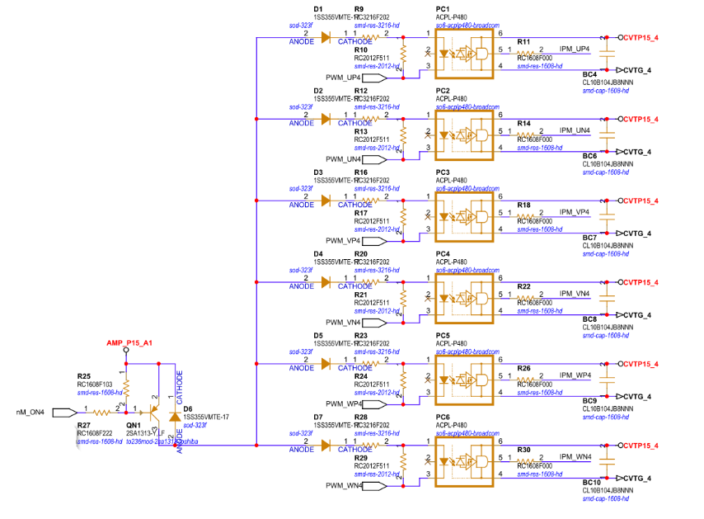
H302-2
When nM_ON4 signal short to Ground (AMP_G_A1)
PWM_UP4
nM_ON4
IPM_UP4
1
2
3
4
Oscilloscpoe

Slide 14
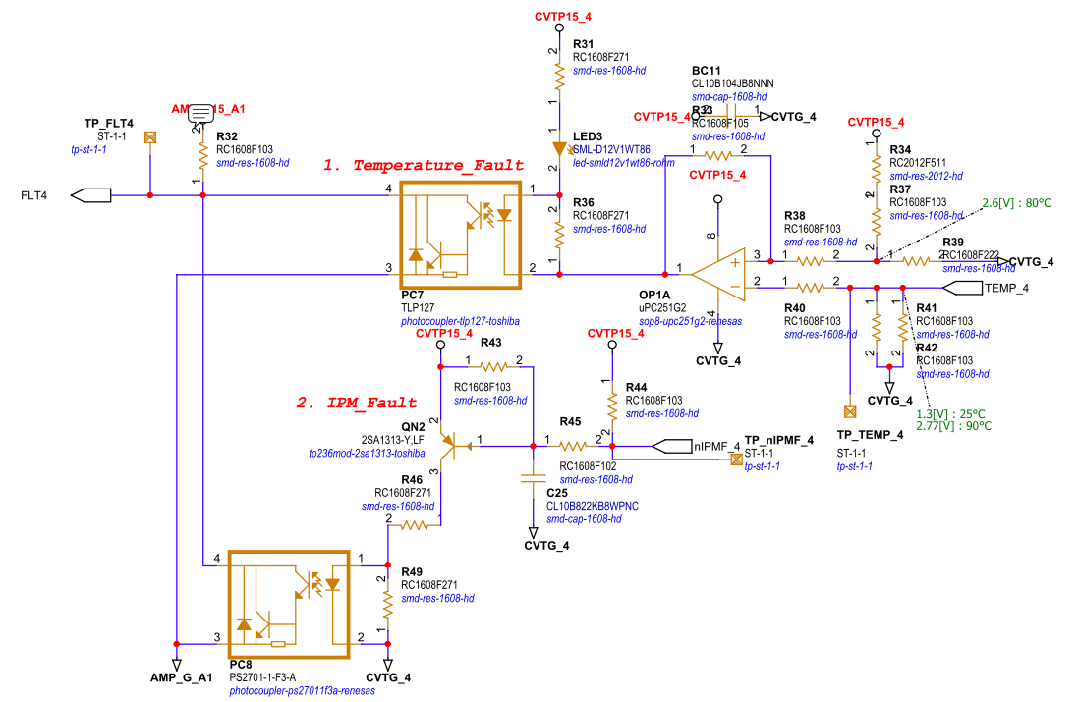
H303
TP_FLT4
TP_TEMP_4
CVTG_4
TP_TEMP_4
Using Controller
+
-
1
2
3
4
Power Supply
Oscilloscpoe
1
TP_FLT4
2
TP_nIPMF_4
1
2
3
4
Oscilloscpoe

Slide 15
Hardware Test report BD65B Controller Test
신제품개발팀 한승한 선임

Slide 16
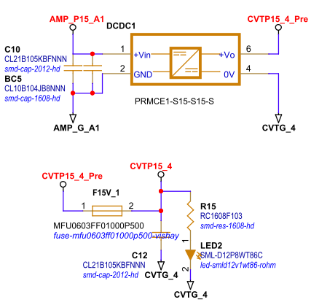
H302-1
Motor-OFF
Motor-OFF -> Motor-ON 되는 순간
Motor-ON 후 로봇 구동 시
CVTP15_4
nM_ON4
1
2
3
4
Oscilloscpoe

Slide 17
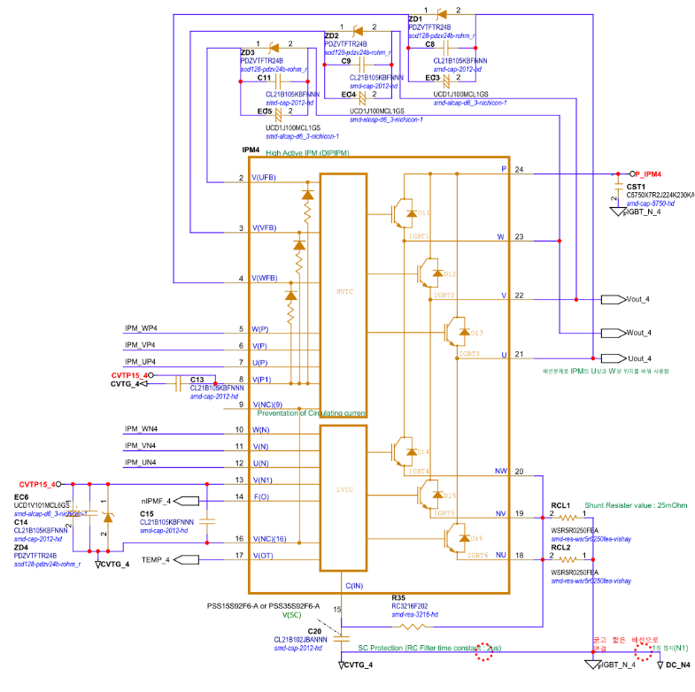
H302-3
Motor-OFF
Motor-OFF -> Motor-ON 되는 순간
Motor-ON 후 로봇 구동 시
EC3 양단
EC5 양단
nM_ON4
EC4 양단
1
2
3
4
Oscilloscpoe

Slide 18
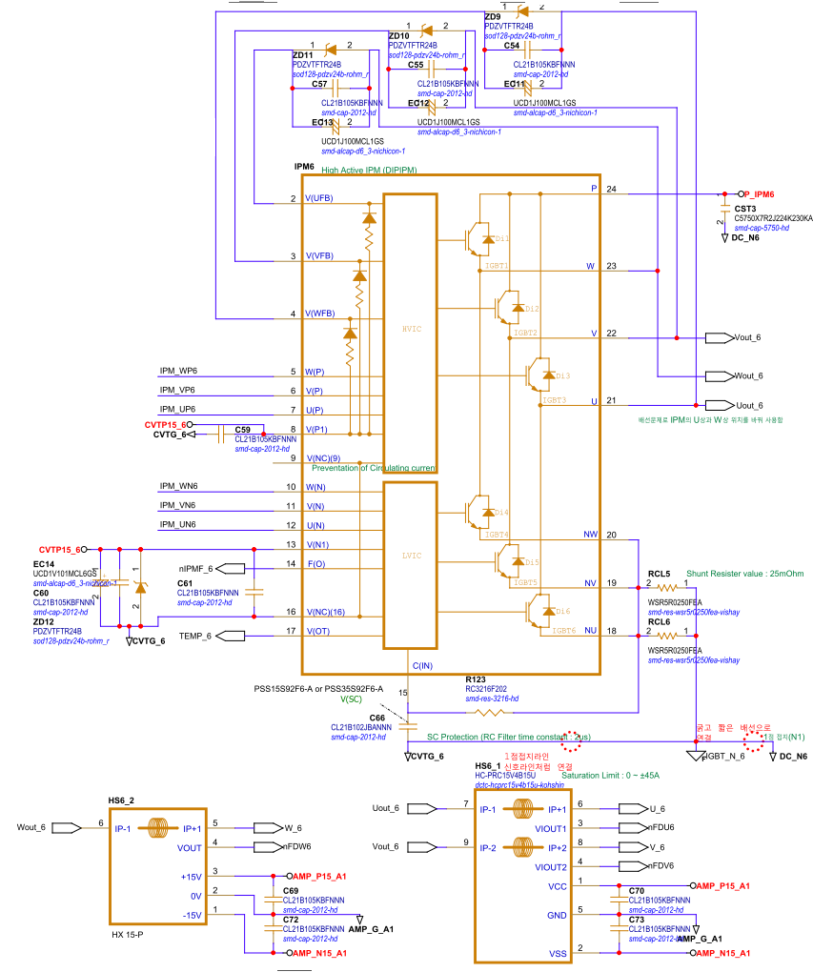
H304
U상 전류센서출력
V상 전류센서출력
U상전류
V상전류
Using Controller
1
2
3
4
Oscilloscpoe
1
U상 전류센서출력
W상 전류센서출력
2
U상전류
W상전류
1
2
3
4
Oscilloscpoe

